Slide 1
Internships 2026 - 2027
School of Computer Science and Statistics
Dr. Tim Savage - Internship Program Director, SCSS
  Ms. Geraline Cole – Internship Administrator, SCSS
    Date 14/09/2026

Slide 2

Purpose of the Internship Module
Academic​
To further develop the student’s understanding of how the design and theoretical aspects of computer science are applied to practical problems within a real-world context.
Professional​
To gain relevant work experience. Build a professional network​ and build your reputation for performance.

Slide 3
Internship Pathway & Eligibility
You must be on the Masters (MCS/MAI) track to take an Internship
Internship is mandatory for MCS students
Internship is optional for MAI students
Eligibility
Students must have a minimum grade of II.1 at the first sitting of the Junior Sophister examinations

Slide 4
Masters track: Graduation 2028
Exit routes:
On completion of the internship, you will return to college to complete you Masters year in year 5 and graduate in 2028.
Students who have selected the internship pathway, and wish to leave after Year 4 will
(i) have the degree of ordinary B.A. conferred (2027) or
(ii) if they have passed all other fourth year requirements, apply to complete a deferred capstone project (the following or subsequent academic year) to be eligible to be conferred with a B.A. (Moderatorship) degree (2028)

Slide 5
Is the Masters worth doing?
MSc Computing is best Masters degree to improve job prospects​
Possibility of Paid Work-based internships​
    Work with a good quality employer​
    Build a long-term career network​
How does an MSc / Internship impact on your career​
  Immediately more employable​
  Many students surveyed said they had been offered or intended to return to company on graduation​
  More interesting / challenging work​

Slide 6
The Big Picture (1)
This is a great opportunity for you — make sure you maximise it.​
You represent us — Trinity College Dublin, SCSS & Engineering.​
You become an employee of your host for the duration of your internship.​
At the same time, you will be working to pursue your academic goals.​
Internship Window:​
  5 - 8 Months, January 2027 – June/July/August 2027

Slide 7
The Big Picture (2)
In Company​
  You have a company supervisor or mentor.​
  You do interesting & challenging work.​
  You have an academic liaison — a member of staff in SCSS.​

Slide 8

Representing TCD
The internship is an integral part of your education at TCD.​
Our reputation is part of the reason you obtained the internship.​
Please make every effort to maintain and enhance that reputation for yourself and future interns.​
Make every effort to be a useful and cooperative professional .​
Bear in mind that the patterns of work and behaviour are very different between College and the workplace – example, time keeping!​
Remember you are TCD “ambassadors”.

Slide 9
Learning Outcomes
Contribute to the design and development of systems at the forefront of computer science and critically evaluate their performance​
Apply theoretical knowledge in an industrial or research laboratory setting to solve real world problems​
Practice and further develop skills in communication, management and teamwork​
Practice and further develop skills in time management and reporting within an industrial or research laboratory setting​
Contribute to an ethical and professional work culture

Slide 10
Assessment
The CS7091 – Internship module is assessed as a Pass/Fail. The assessment consists of 2 parts:
CS7091-Part1 (50%) – Mid-term Report and Presentation (usually in-company)
CS7091-Part2 (50%) – Final Report
MCS-pathway students must pass both parts of their internship assessment in order to proceed. Internship marks do not contribute to the overall 4th year mark for MCS-pathway students. 4th year marks are calculated based on 4th year taught modules only.

Slide 11
Assessment
Assessment Component | Brief Description | LO’s | % of Total | Week Set | Deadline
Part 1 – Mid-Point Report | A report containing their goals, their reflective journal and an analysis of the software engineering management in the company. | LO1-LO5 | 40% | 1 | April 12th 2027
Part 1 – In-Company Presentation | Presentation to industry Mentor and Academic Supervisor. | LO3, LO4 | 10% | 1 | April 1st – April 30th 2027
Part 2 – Final Report | Report on the technology design worked on during internship, reflection on Goals, reflective learning journal. | LO1-LO5 | 50% | 1 | July 13th 2027
For full descriptions of the components, see the Internship Handbook

Slide 12
From the ICS Course Handbook
The 30 ECTS credits obtained in the internship in the MCS are split as follows:
CS7091-Part1 (10 ECTS) – e.g., Mid-term Report, Presentation (usually in-company)
CS7091-Part2 (20 ECTS) – e.g., Final Report
The second part (20 ECTS) is only part of the MCS pathway and has no ECTS credit in the BA Mod degree pathway. MCS-pathway students must pass both parts of their internship assessment in order to proceed. Internship marks do not contribute to the overall 4th year mark for MCS-pathway students. 4th year marks are calculated based on 4th year taught modules only.
Students switching from the MCS to the BA Mod pathway have two options to replace the 30 ECTS of the internship:
Complete CS7091-Part1 (10 ECTS) in their 4th year and combine with the deferred capstone (FYP, 20 ECTS) taken in the following academic year.
Request to complete the Group Design Project (10 ECTS) instead of the internship and combine this with the deferred capstone project (FYP, 20 ECTS) taken in the following academic year. This request is only possible before the start of the second semester.

Slide 13
Internship Sessions
Session | Date | Time | Location
Creating a CV and SpeedConnect | Wed 16th Sept | 1pm-2pm | Maxwell Theatre
Interviews and SpeedConnect | Mon 21st Sept | 1pm-2pm | LB01
SpeedConnect | Wed 23rd Sept | 9.30am - 1.30pm | Trinity Innov. Hub
SpeedConnect debrief & Offers | Mon 28th Sept | 1pm-2pm | LB01
Internship/Students Experience | Mon 5th Oct | 1pm-2pm | LB01
Assessment Guidelines | Mon 12th Oct | 1pm-2pm | LB01
Reflection Guidelines | Mon 19th Oct | 1pm-2pm | LB01
Making the best of the Experience | Mon 2nd Nov | 1pm-2pm | Lb01

Slide 14

Blackboard module
Content
Internship Handbook & FAQ
  SCSS Internship Handbook
  Frequently Asked Questions
Slides and Resources
  Sample CV, Cover Letter & Interview Q’s
  Slides from weekly sessions
Job Descriptions & Agreements
  Internship Application Information
  Job Descriptions
  Internship Tri-party Agreement
  Overseas safety statement

Slide 15

Blackboard module:
Internship Application Information
You can start applying as soon as you are ready.
Please don't apply for internships which you will not take.
Keep a log of what you have applied for.
Once you've accepted an offer never rescind!
Once you have accepted an offer inform the module co-ordinator

Slide 16
The Process - Applying
 | Approved internships from our Industry Partners will be shared on BlackBoard.
 | Students apply directly to the companies for the roles that interest them.
 | Each company uses their normal HR process to hire Interns. May include – technical assessments, interview(s) -> offer
 | Offers should be complete by 30th November 2026. Internship Agreements signed before starting. (Guideline)
 | If a student finds / is offered a role not listed on BlackBoard – check with co-ordinator before signing anything.
 | Internships outside of Ireland are permitted-ask co-ordinator for details.

Slide 17
The Process - Accepting
 | Never accept and offer you do not intend to take the position.
 | If you need additional time to make a decision – ask the company – they may or may not give you time but it's worth asking.
 | If you decide to decline an offer – do so as soon as you can and thank the company.
 | Offers should be complete by 30th November 2026. Internship Agreements signed before starting.
 | Once you accept an offer –complete the internship agreement and send to the company for signing. Internship co-ordinator will get it signed by Trinity / SCSS.

Slide 18

Internship Speed Connect
Wednesday 23rd of September, 9.30 - 1.30pm
In-person event
Opportunity to meet with multiple companies in a fun, fast-paced format.
Prior to event students will book into slots with up to 10 companies.
Networking opportunities during break.
Attendance is mandatory unless you already have an internship.
New Location Trinity Innovation Hub

Slide 19
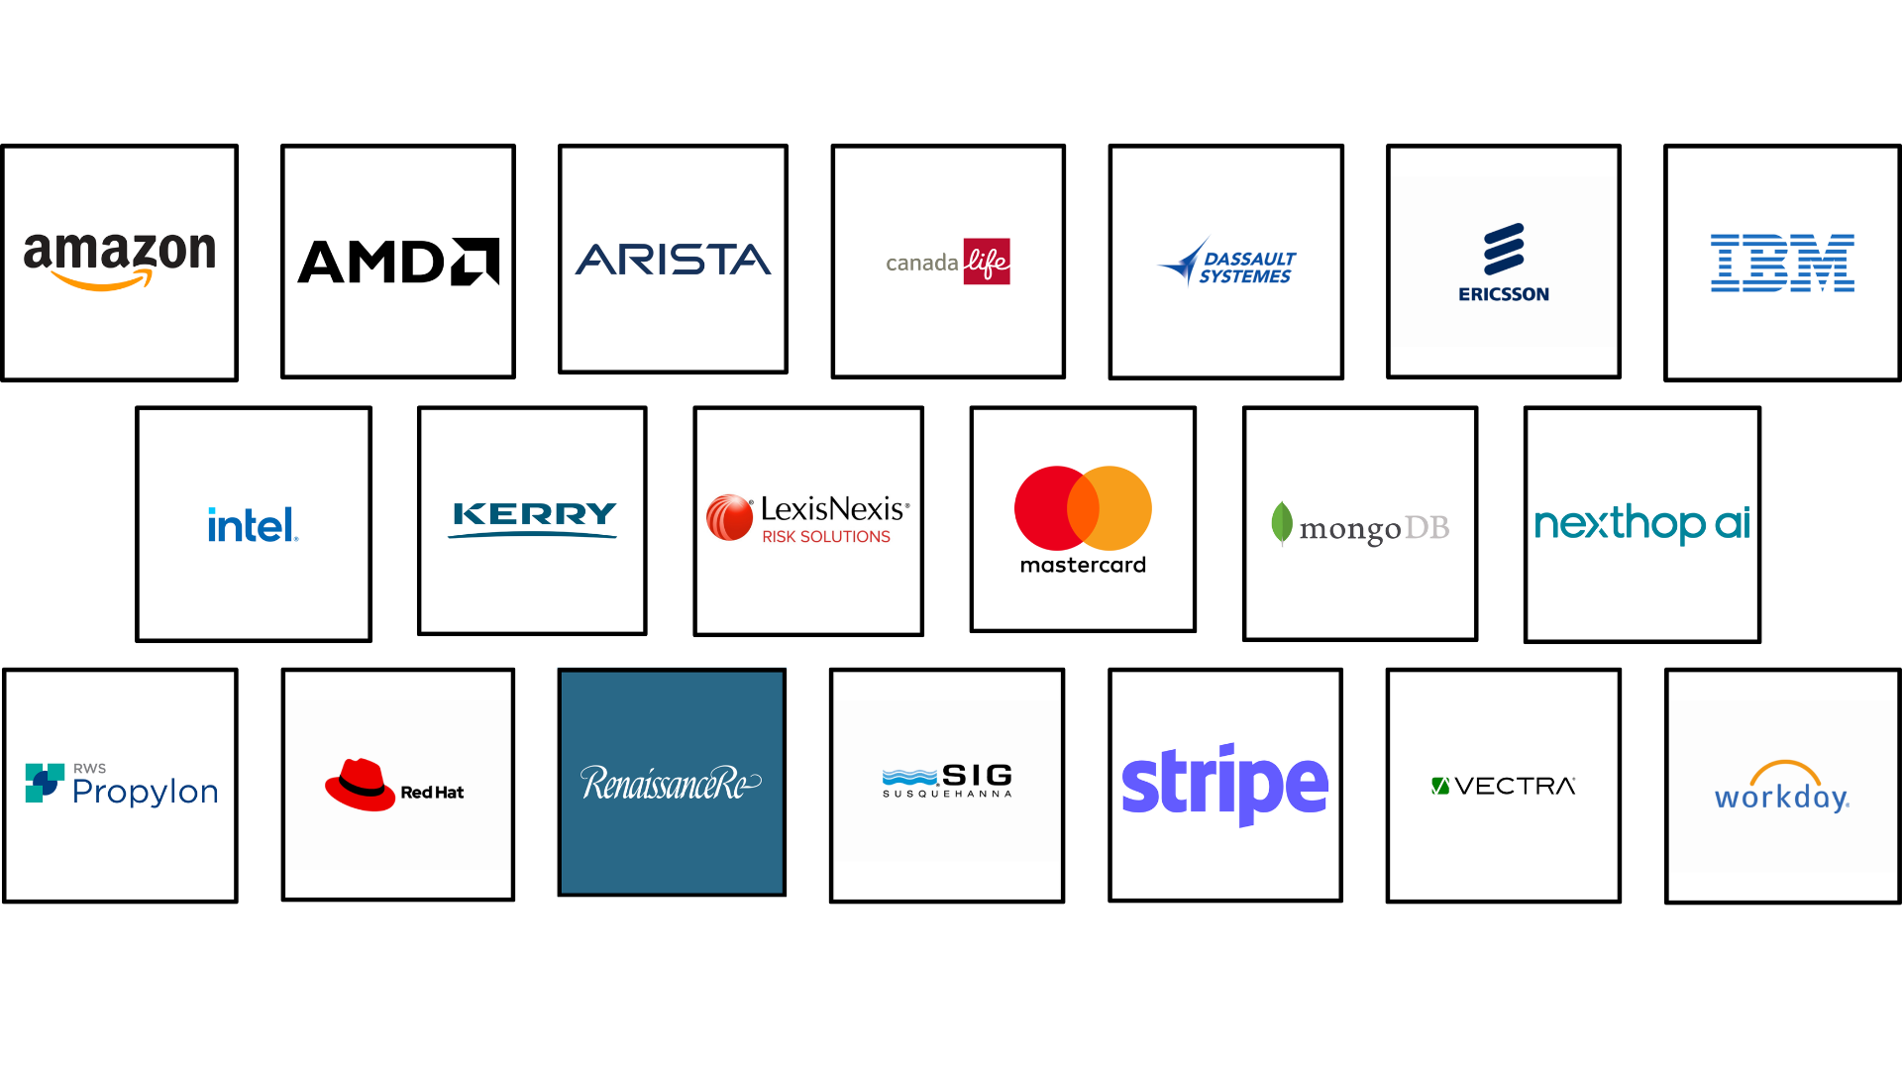
Speed Connect Attendees 2025

Slide 20
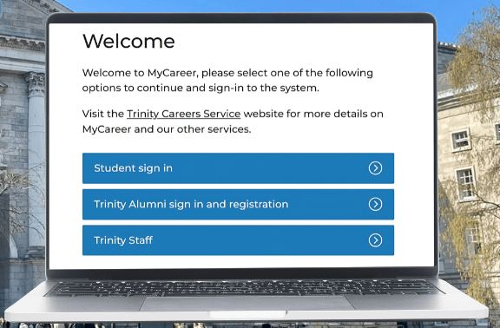
Trinity MyCareer Portal
Make sure your profile is activated and updated
Login here: https://mycareerconnect.tcd.ie/unauth/student/login
Essential for booking the following:
  Speed Connect
  CV Clinics

Slide 21
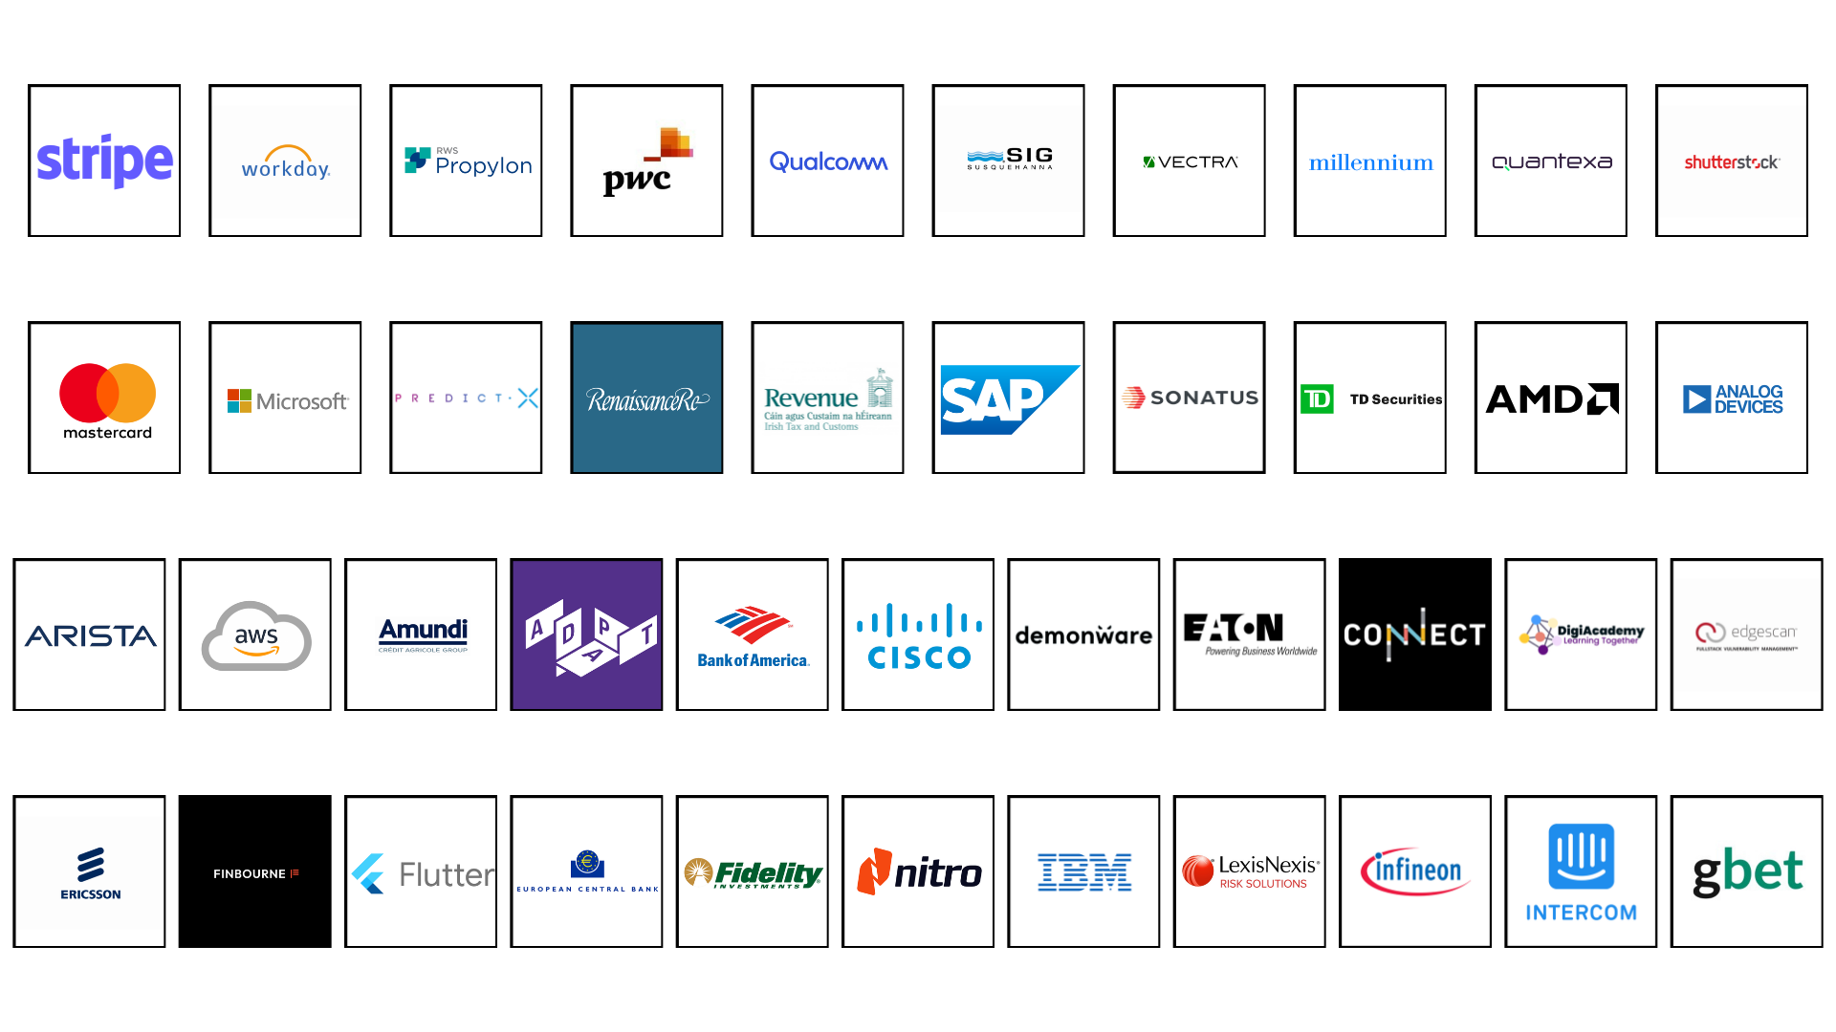
Industry Partners

Slide 22
What our 2025 interns have to say:
1. Would you recommend your host company to another student?
100% Yes

Slide 23
Practicalities
Communication
Blackboard
Updates will be made via Announcements on Blackboard
Roles will be added regularly to the Internship Application Information page
Emails
Make sure you are checking your emails regularly, especially whatever account you have used for university applications
Remember to be professional in all communications with potential employers
Be prepared to answer phone calls!
Invitations to attend interview or job offers may be made by phone.

Slide 24
Available Additional Support – Disability Service
1. If you are registered with the Disability Service, they can support you in identifying any reasonable accommodations that you may need in the workplace.
Steps for applying for a Needs Assessment:
  Register with the Disability Service
  You will be invited for a needs assessment
  If you are already registered with the DS, please email askds@tcd.ie and you will receive an internship specific needs assessment. In your email.

Slide 25
Available Additional Support - TAP
2. If you accessed this programme via Trinity Access Programme, you can access additional support with the application process through this service.
To find out more, you can contact the TAP team at tapundergraduates@tcd.ie
3. If English is not your first language and you need to improve your fluency, you can access In-Sessional Fluency classes
https://www.tcd.ie/slscs/centre-for-english-language-learning-and-teaching/in-sessional-programmes/modules/

Slide 26
Next Steps – Additional session this week
 | Wednesday 16th September
 | 1pm – 2pm
 | Maxwell theatre Hamilton
 | Choosing the right internship for you What employers want to know Job descriptions Key elements of a CV Cover letters/emails Speed Connect
 | Wednesday 16th September
 | 1pm - 2pm
 | Maxwell Theatre Hamilton

Slide 27
Next Steps
Month | Activity
September | Company Research CV preparation and CV Clinics – Careers Portal Apply for internships Attend SpeedConnect
October | Continue applications Interviews
November | Accept Offer Return Internship Agreement
January | Start Internship

Slide 28
Keep in touch!
Ms. Geraline Cole
Internships Coordinator
Internships@scss.tcd.ie
Dr. Tim Savage
Internship Programme Director
Internships@scss.tcd.ie
The internships email will reach both of us.
Do not hesitate to get in touch, if you have any questions or concerns.

Slide 29
Best of luck!

